Slide 1





Supervised & Unsupervised Encoding Schemes of Binary Variables for Prediction Performance Enhancement
Institute of Industrial Engineering, NTU
Yun-Hao Yang, Jakey Blue
Notes:
國科會、台大
主標 - 全名
副標 - 姓名

Slide 2
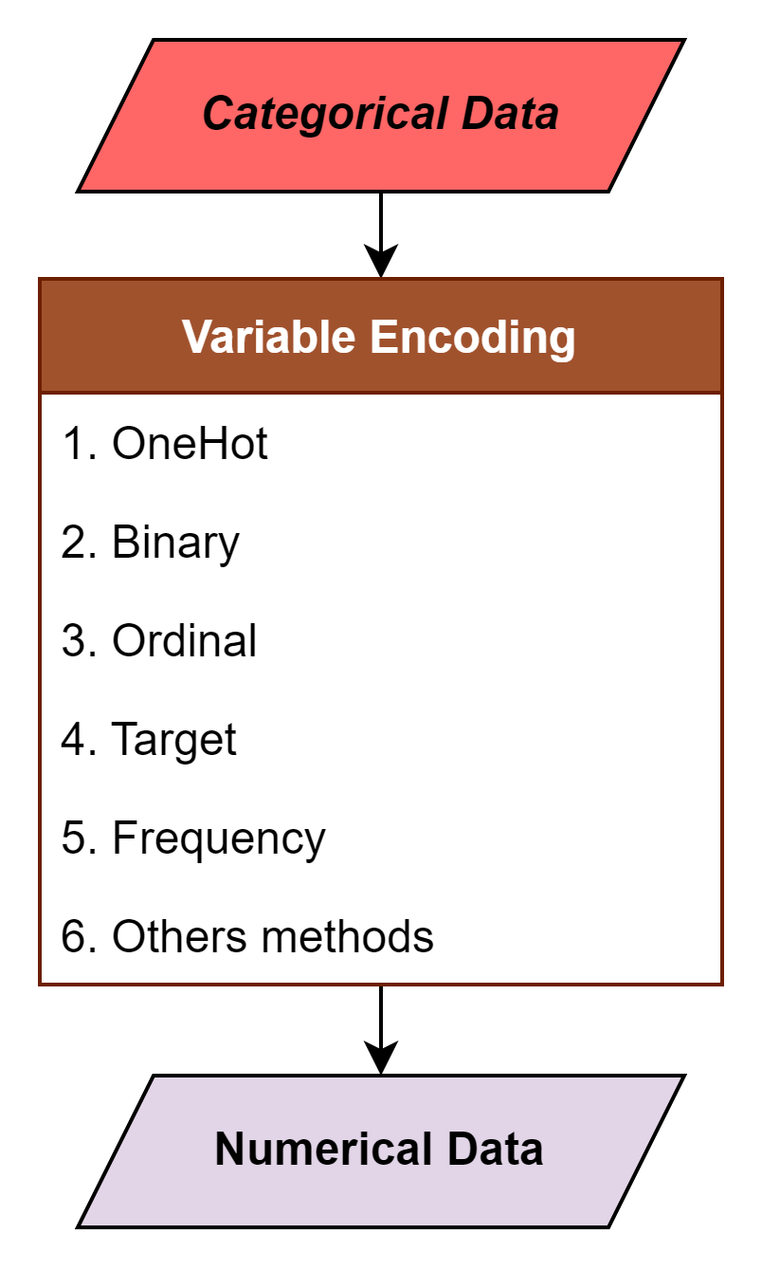
Motivation
Shape
■
▲
●
Categorical |  | Numerical
City |  | Ordinal | Binary |  | One Hot |  |  |  | Frequency
Taipei |  | 0 | 0 | 0 | 0 | 0 | 0 | 1 | 0.2
New York |  | 1 | 0 | 1 | 0 | 0 | 1 | 0 | 0.2
London |  | 2 | 1 | 0 | 0 | 1 | 0 | 0 | 0.2
Tokyo |  | 3 | 1 | 1 | 1 | 0 | 0 | 0 | 0.4
Tokyo |  | 3 | 1 | 1 | 1 | 0 | 0 | 0 | 0.4
ENCODER
■ | ▲ | ●
0 | 0 | 1
0 | 1 | 0
1 | 0 | 0
Notes:
Variable encoding is need for transforming the categorical data. Many encoding method had been invented to fulfill such task. Among all, One hot encoding is the one of the most commonly used method.

Slide 3
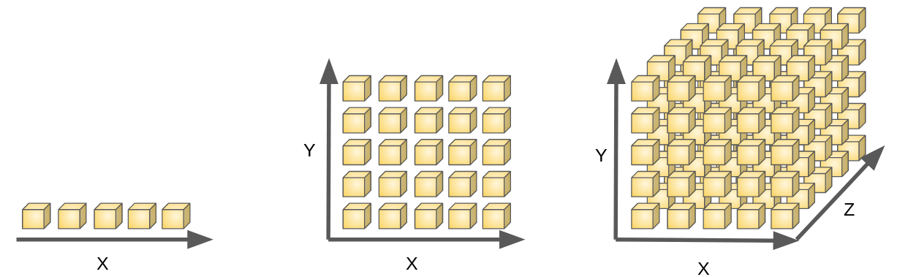
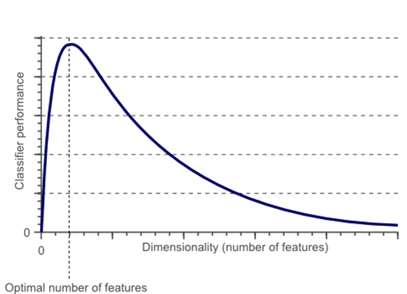
Motivation
Categorical | Animal
 | Cow
 | Tuna
 | ⁝
 | Frog
One Hot
Binary | Animal
 | Tuna | Cat | Frog | Cod | Goat | Dog | … | Cow
 | 0 | 0 | 0 | 0 | 0 | 0 |  | 1
 | 1 | 0 | 0 | 0 | 0 | 0 |  | 0
 | ⁝ | ⁝ | ⁝ | ⁝ | ⁝ | ⁝ |  | ⁝
 | 0 | 0 | 1 | 0 | 0 | 0 |  | 1
Notes:
Luckily if the data follow the strict format of One Hot encoding, we might reverse it back to the categorical data and use other encoding methods (such as target, ordinal encode) to generate the numerical data. Yet, If the data violate the rule of it, what can we do to down size the features? While advoid the numerous 0? While looking into One Hot encoded data, We can easily see multiple features, in which rare 1 surrounded by numerous 0. However, It’s not very preferable for the machine learning model, for the following 2 reasons
Too many features yield the curse of dimensionality.
Numerous 0 can’t calculate the gradient, makes most ML boosting algorithm invalid.

Slide 4
Motivation
Categorical | Animal | Size | Color
 | Cow | Big | White
 | Tuna | Med | Black
 | ⁝ | ⁝ | ⁝
 | Frog | Tiny | Green
Other Encoding
Numerical | Animal | Size | Color
 | 10 | 4 | 7
 | 2 | 3 | 6
 | ⁝ | ⁝ | ⁝
 | 7 | 1 | 3
One Hot
Binary | Animal |  |  |  |  |  |  |  | Size |  |  |  | Color
 | Tuna | Cat | Frog | Cod | Goat | Dog | Toad | Cow | Large | Mid | Small | Tiny | White | Black | Red | Blue | Green | Gray
 | 0 | 0 | 0 | 0 | 0 | 0 | 0 | 1 | 1 | 0 | 0 | 0 | 1 | 0 | 0 | 0 | 0 | 0
 | 1 | 0 | 0 | 0 | 0 | 0 | 0 | 0 | 0 | 1 | 0 | 0 | 0 | 1 | 0 | 0 | 0 | 0
 | ⁝ | ⁝ | ⁝ | ⁝ | ⁝ | ⁝ | ⁝ | ⁝ | ⁝ | ⁝ | ⁝ | ⁝ | ⁝ | ⁝ | ⁝ | ⁝ | ⁝ | ⁝
 | 0 | 0 | 1 | 0 | 0 | 0 | 0 | 1 | 0 | 0 | 0 | 1 | 0 | 0 | 0 | 0 | 1 | 0
Notes:
In machine learning, we often stumble upon datasets contains with multiple categorical features. To let the computer understand those categorical data, variable encoding is needed, which helps transform the data.
Until today, many encoding methods had been created for this such circumstances
Among all methods, One Hot encoding is the most commonly used for such scenario for its convenience and efficiency, By creating mutually exclusive dummy variable for each category in each categorical feature.
Yet many problems might come along with it…

Slide 5


Motivation
Numerical | Group 1 | Group 2 | Group 3
 | 10 | 4 | 7
 | 2 | 3 | 6
 | ⁝ | ⁝ | ⁝
 | 7 | 1 | 3
When the data is not follow the One Hot rule, can’t use other method to transform the binary data. If only can we find a way in representing the numerous binary features data in a much simple way...
Binary | Tuna | Cat | Frog | Cod | Goat | Dog | Toad | Cow | Large | Mid | Small | Tiny | White | Black | Red | Blue | Green | Gray
 | 0 | 0 | 0 | 0 | 0 | 0 | 0 | 1 | 1 | 0 | 0 | 0 | 1 | 0 | 0 | 0 | 0 | 0
 | 1 | 0 | 0 | 0 | 0 | 0 | 0 | 0 | 0 | 1 | 0 | 0 | 0 | 1 | 0 | 0 | 0 | 0
 | ⁝ | ⁝ | ⁝ | ⁝ | ⁝ | ⁝ | ⁝ | ⁝ | ⁝ | ⁝ | ⁝ | ⁝ | ⁝ | ⁝ | ⁝ | ⁝ | ⁝ | ⁝
 | 0 | 0 | 1 | 0 | 0 | 0 | 0 | 1 | 0 | 0 | 0 | 1 | 0 | 0 | 0 | 0 | 1 | 0
Notes:
In machine learning, we often stumble upon datasets contains with multiple categorical features. To let the computer understand those categorical data, variable encoding is needed, which helps transform the data.
Until today, many encoding methods had been created for this such circumstances
Among all methods, One Hot encoding is the most commonly used for such scenario for its convenience and efficiency, By creating mutually exclusive dummy variable for each category in each categorical feature.
Yet many problems might come along with it…

Slide 6
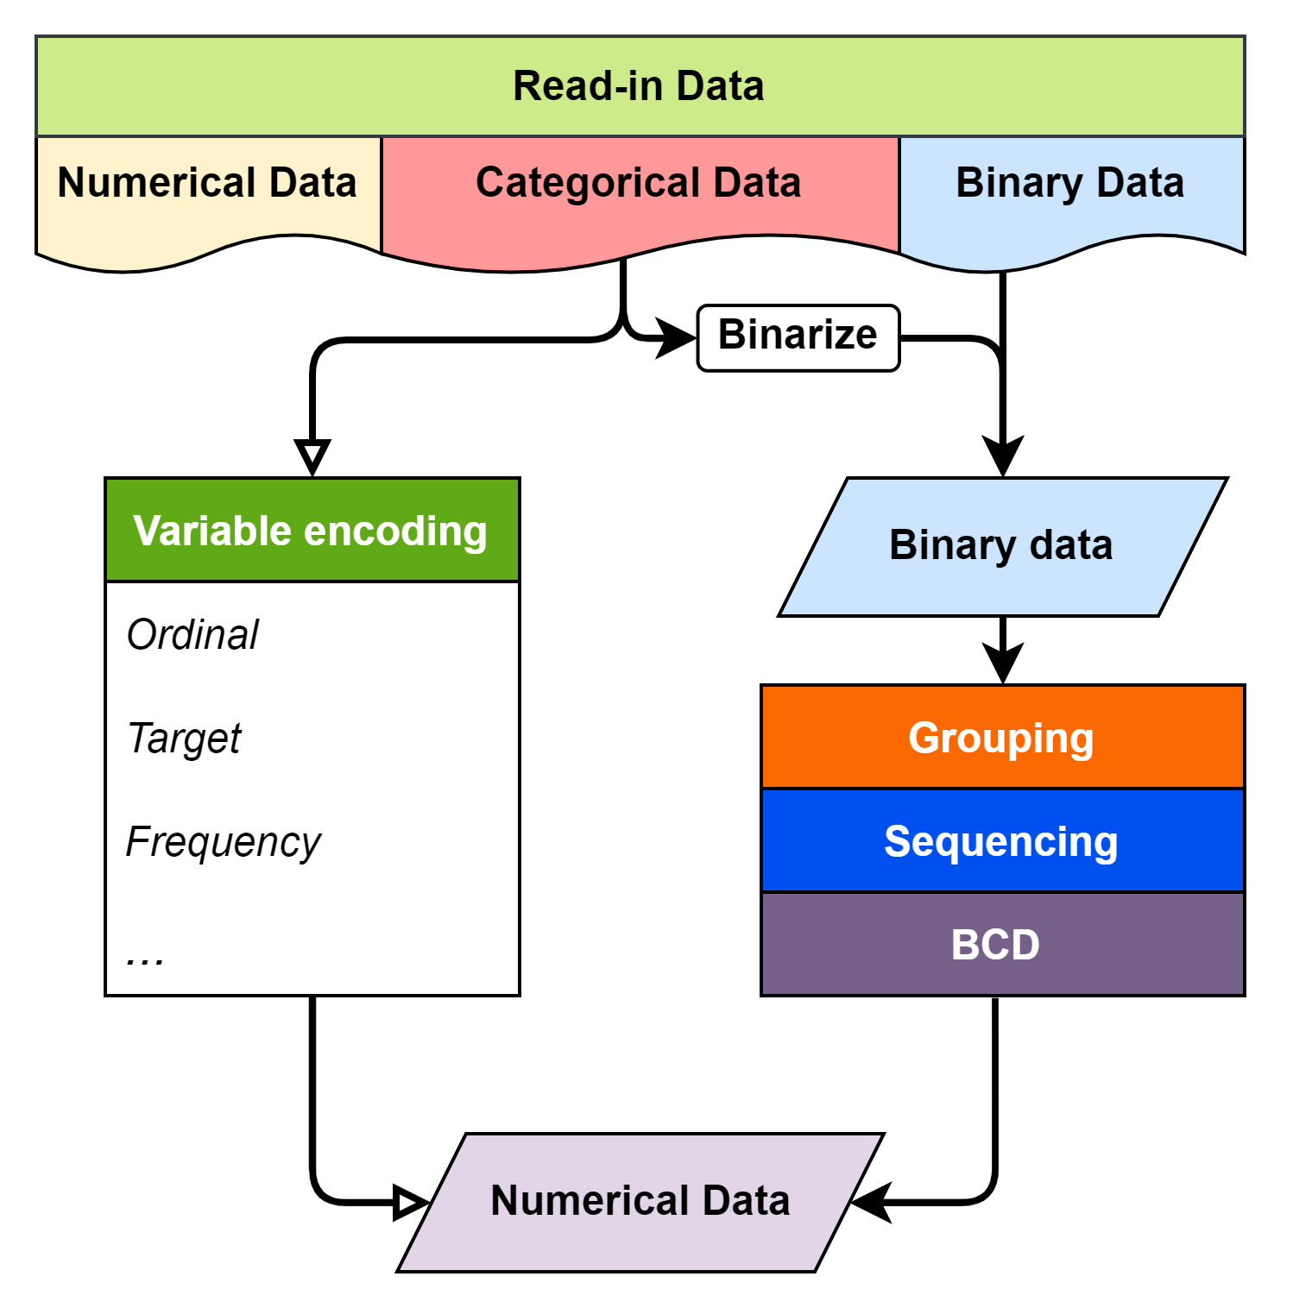
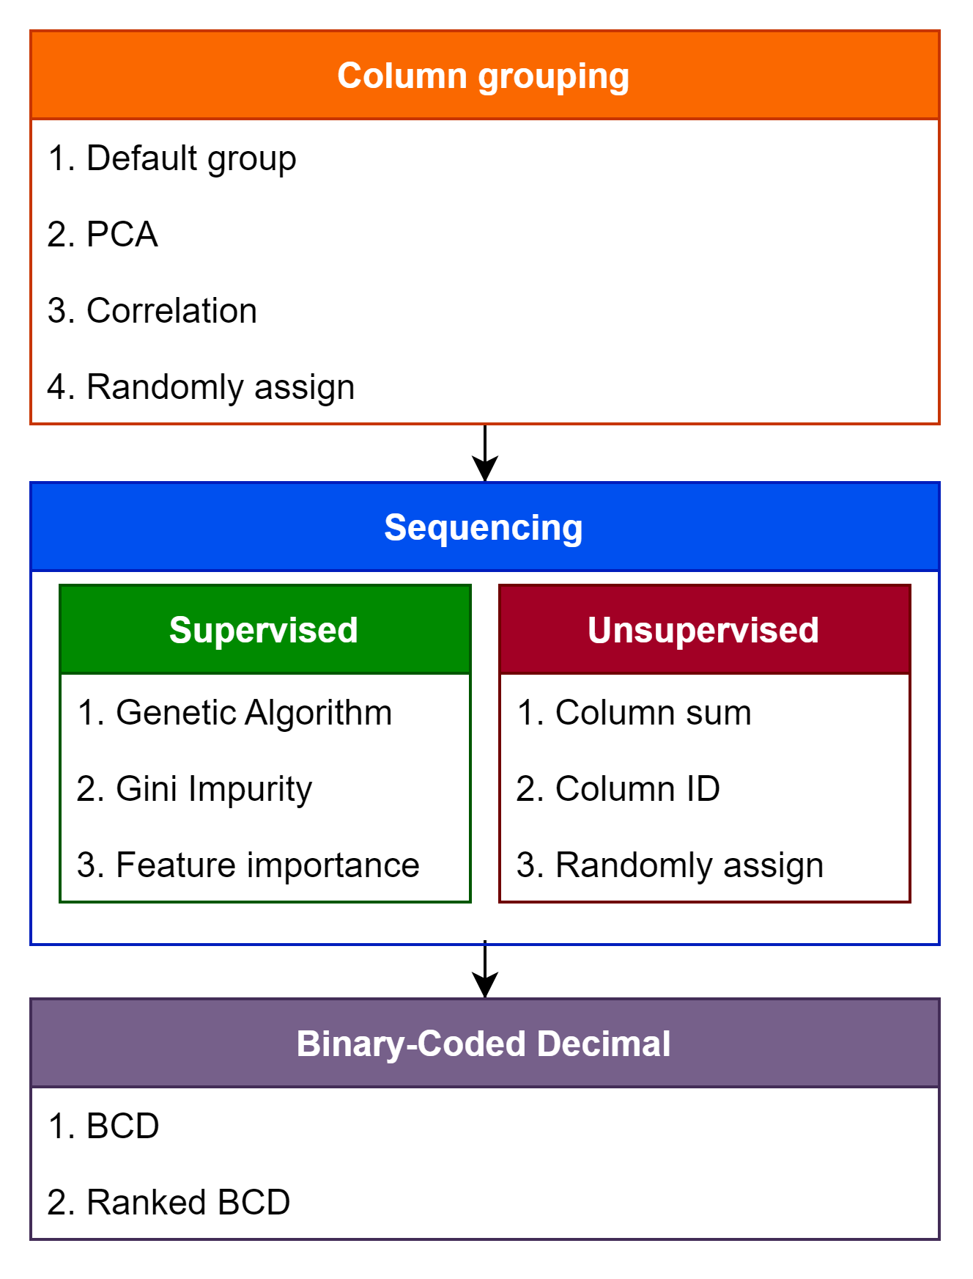
Methodology
Col 6 | Col 2 | Col 5 | Col 4 | Col 1 | Col 3
0 | 1 | 0 | 1 | 1 | 0
0 | 0 | 1 | 1 | 1 | 0
⁝ | ⁝ | ⁝ | ⁝ | ⁝ | ⁝
1 | 0 | 1 | 0 | 0 | 1
Notes:
拉開些
Numerical part ➔

Slide 7
Methodology
Group
Sequence
BCD
In the research, we propose a method to encode binary data in to numerical data. Via grouping, sequencing and transforming the binary row data with BCD encode.
Grouping similar, correlated features
Sequencing features in each feature group
BCD encode on each feature group
Tiny | Cat | Large | Black | White | Cow
1 | 1 | 0 | 1 | 0 | 0
0 | 0 | 1 | 0 | 1 | 1
⁝ | ⁝ | ⁝ | ⁝ | ⁝ | ⁝
0 | 0 | 1 | 0 | 1 | 1
Col 1 | Col 2 | Col 3 | Col 4 | Col 5 | Col 6
1 | 1 | 0 | 1 | 0 | 0
1 | 0 | 0 | 1 | 1 | 0
⁝ | ⁝ | ⁝ | ⁝ | ⁝ | ⁝
0 | 0 | 1 | 0 | 1 | 1

Slide 8
Methodology
Group
Sequence
BCD
In the research, we propose a method to encode binary data in to numerical data. Via grouping, sequencing and transforming the binary row data with BCD encode.
Grouping similar, correlated features
Sequencing features in each feature group
BCD encode on each feature group
Tiny
1
0
⁝
0
Cat
1
0
⁝
0
Large
0
1
⁝
1
Black
1
0
⁝
0
White
0
1
⁝
1
Cow
0
1
⁝
1

Slide 9
Methodology
Group
Sequence
BCD
In the research, we propose a method to encode binary data in to numerical data. Via grouping, sequencing and transforming the binary row data with BCD encode.
Grouping similar, correlated features
Sequencing features in each feature group
BCD encode on each feature group
Cat
1
0
⁝
0
Cow
0
1
⁝
1
Black
1
0
⁝
0
White
0
1
⁝
1
Tiny
1
0
⁝
0
Large
0
1
⁝
1

Slide 10
Methodology
Group
Sequence
BCD
In the research, we propose a method to encode binary data in to numerical data. Via grouping, sequencing and transforming the binary row data with BCD encode.
Grouping similar, correlated features
Sequencing features in each feature group
BCD encode on each feature group
Cow | Cat | White | Black | Tiny | Large
0 | 1 | 0 | 1 | 1 | 0
1 | 0 | 1 | 0 | 0 | 1
⁝ | ⁝ | ⁝ | ⁝ | ⁝ | ⁝
1 | 0 | 1 | 0 | 0 | 1

Slide 11
Methodology
Group
Sequence
BCD
In the research, we propose a method to encode binary data in to numerical data. Via grouping, sequencing and transforming the binary row data with BCD encode.
Grouping similar, correlated features
Sequencing features in each feature group
BCD encode on each feature group
Animal | Color | Size
1 | 1 | 2
2 | 2 | 1
⁝ | ⁝ | ⁝
2 | 2 | 1

Slide 12

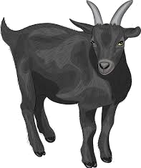
Methodology - Grouping
Group
Sequence
BCD
Binary Data (Total:300 sample, 200 good, 100 bad)
Animal
Cow | Cat | Goat | Dog | Frog | Toad | Tuna | Cod
 |  | V
counts
Size
Large | Mid | Small | Tiny
 | V
counts
Color
White | Black | Gray | Red | Blue | Green
 | V
Health Status
Good | Bad
 | V
counts
Notes:
別用 case study 的圖
簡單範例
Excel
Grouping ➔ feature selection, 決定新資料維度

Slide 13
Methodology - Grouping
Group
Sequence
BCD
Binary Data | Grouped by PCA

Slide 14
Methodology - Sequencing
Group
Sequence
BCD
Grouped by PCA
Secondly, sequencing features in each group by columns’ attributes, for outputting better BCD values after encode.
Column sum
Type impurity
Feature importance
Notes:
Sequencing ➔ 區分出不同的 tpye

Slide 15
Methodology - Sequencing
Group
Sequence
BCD
Grouped by PCA | Sequenced by column sum
Notes:
Sequencing ➔ 區分出不同的 tpye

Slide 16
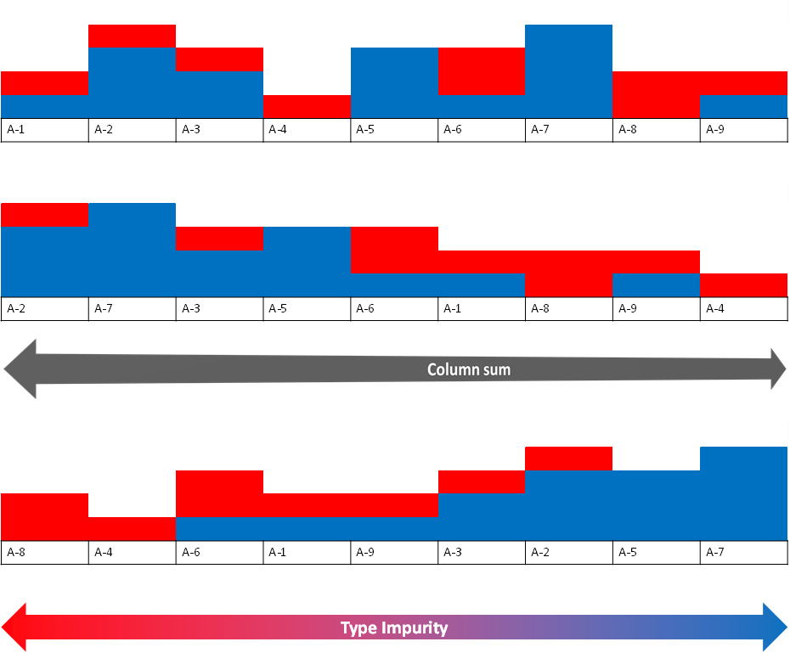
Methodology - Sequencing
Group
Sequence
BCD
Group
Sequence | No Seq.
 | Impurity
BCD value
No Seq.
Impurity
Notes:
Encode 完的比較

Slide 17
Methodology - BCD code
Group
Sequence
BCD
Group
Sequence
BCD |  | Sorted Column Group |  |  |  |  |  |  | Type
 |  | Blue | Tuna | Tiny | Toad | Green | Cod
33 |  | 1 | 0 | 0 | 0 | 0 | 1 |  | Good
36 |  | 1 | 0 | 0 | 1 | 0 | 0 |  | Good
26 |  | 0 | 1 | 1 | 0 | 1 | 0 |  | Bad
14 |  | 0 | 0 | 1 | 1 | 1 | 0 |  | Bad
Decimal digit | BCD
 | 8 | 4 | 2 | 1
0 | 0 | 0 | 0 | 0
1 | 0 | 0 | 0 | 1
2 | 0 | 0 | 1 | 0
3 | 0 | 0 | 1 | 1
4 | 0 | 1 | 0 | 0
5 | 0 | 1 | 0 | 1
6 | 0 | 1 | 1 | 0
7 | 0 | 1 | 1 | 1
8 | 1 | 0 | 0 | 0
9 | 1 | 0 | 0 | 1
Notes:
At last, by using Binary-coded decimal technique, each grouped feature can be transform into numerical type. In the end, the new encoded data will have $j$ numerical features.

Slide 18
Methodology - sum up
1. | Column Grouping
 | Clustering related or similar columns together into groups.
2. | Sequencing
 | Rearrange columns in group, for a more distinctive /competitive BCD value.
3. | Binary-Coded Decimal
 | Transform column groups into a numerical value with BCD.
Original
Randomly
Impurity
Notes:
At last, by using Binary-coded decimal technique, each grouped feature can be transform into numerical type. In the end, the new encoded data will have $j$ numerical features.

Slide 19
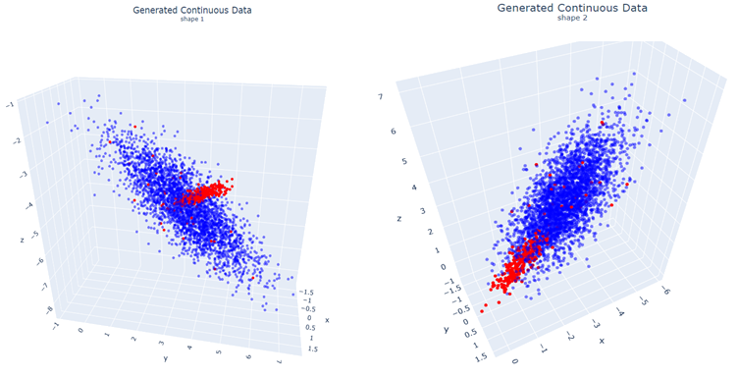
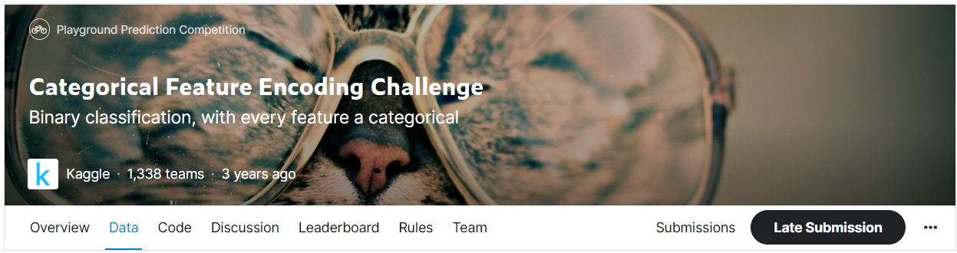
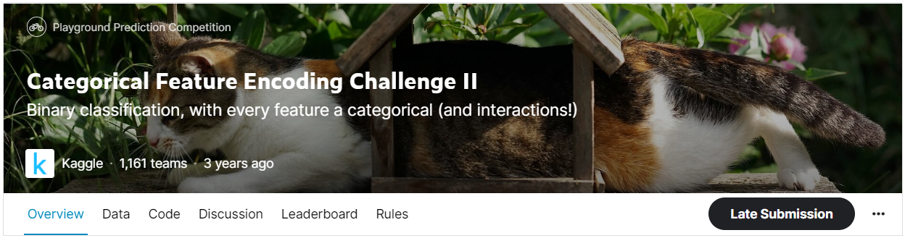
Case study
In Case study, we compare classification results with the commonly used variable encoding method under different datasets.
Simulated datasets
Kaggle dataset
Notes:
Only categorical feature encoding challenge

Slide 20
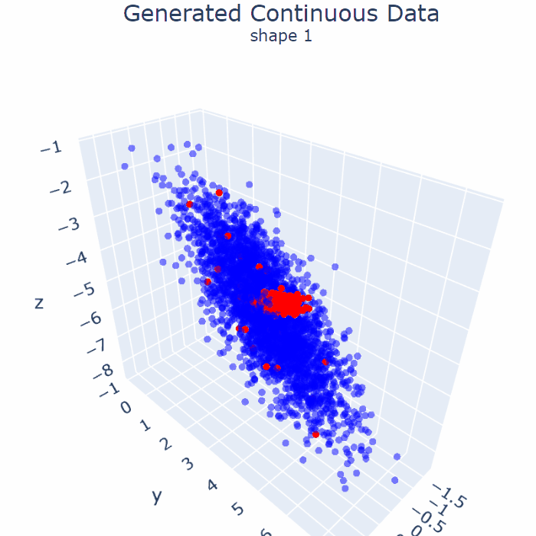
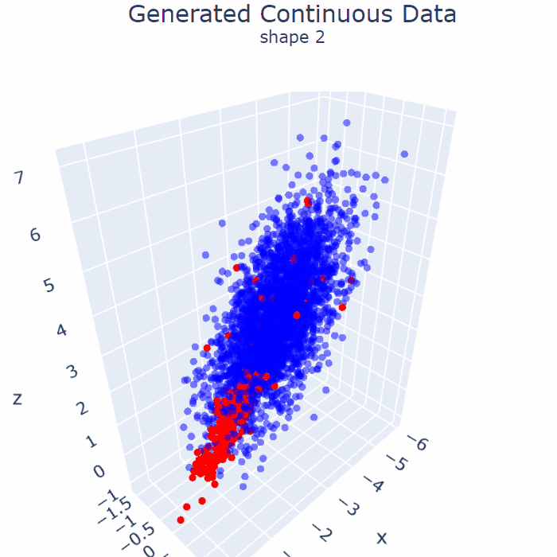
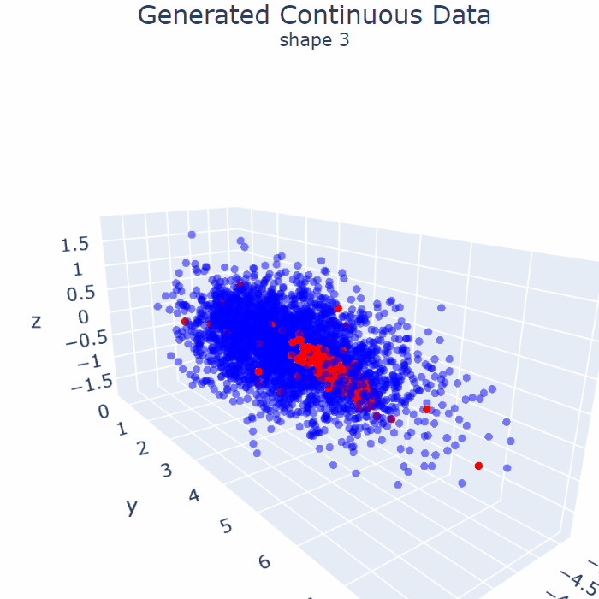
Simulated data (3300 samples, 3000 Good, 300 Bad)
Dataset 1 |  | Dataset 2 |  | Dataset 3

Slide 21
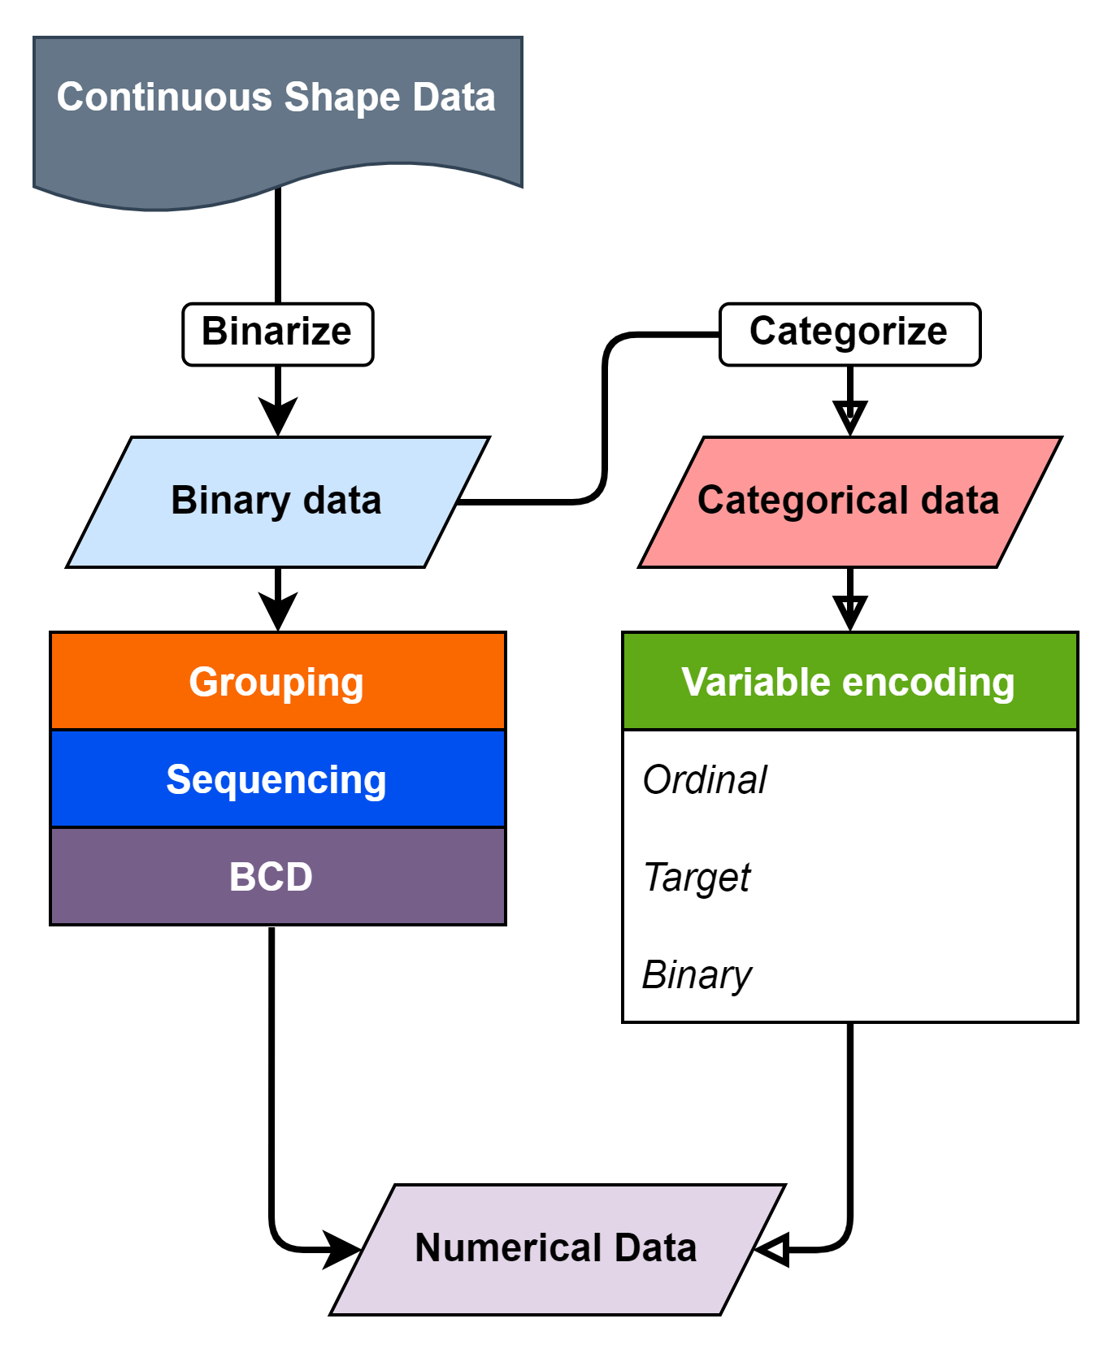
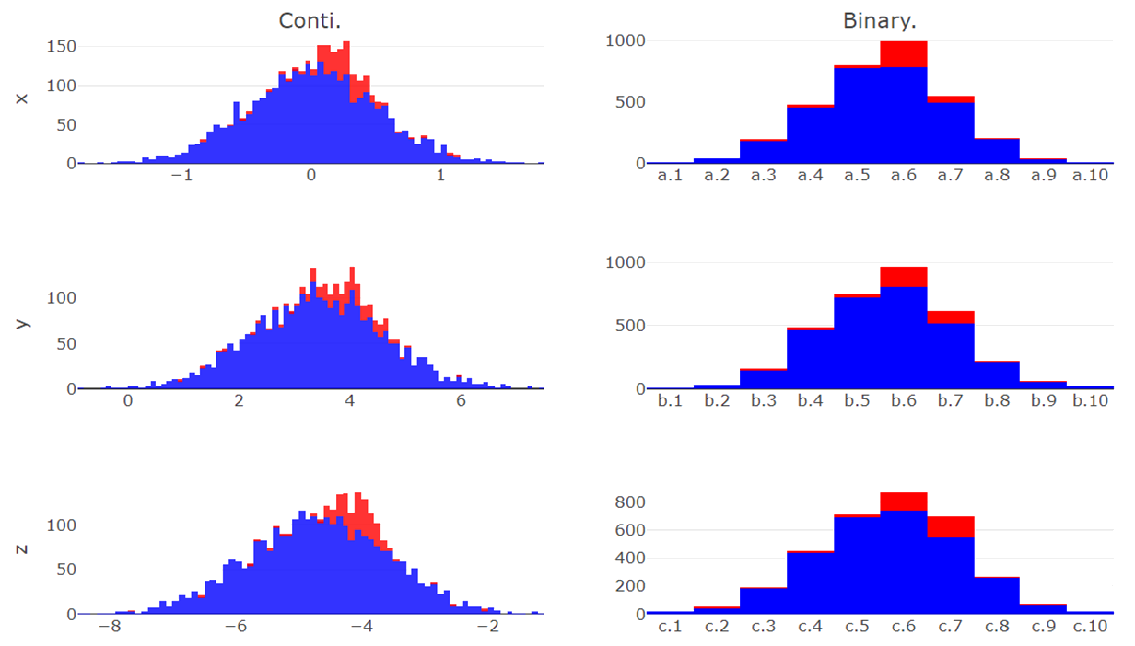
Simulated data - binarize
z.1 | z.2 | z.3 | z.4 | z.5 | z.6 | z.7 | z.8 | z.9 | z.10
y.1 | y.2 | y.3 | y.4 | y.5 | y.6 | y.7 | y.8 | y.9 | y.10
x.1 | x.2 | x.3 | x.4 | x.5 | x.6 | x.7 | x.8 | x.9 | x.10
Continuous Data | Binarize Data
counts
counts
X
counts
counts
Y
counts
counts
Z
Notes:
From two type continuous data, we slicing each axis and view the grid we sliced as a categorical data, for generating binary features with knowledge.

Slide 22
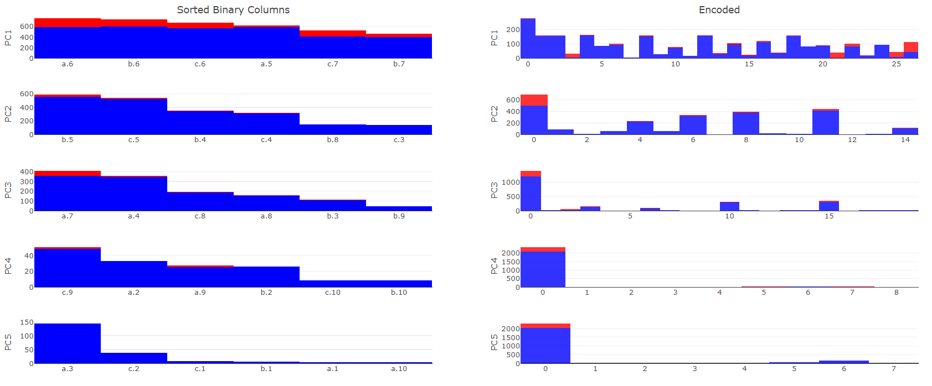
Simulated data - seq. by sum
Sequence by column sum | BCD

Slide 23
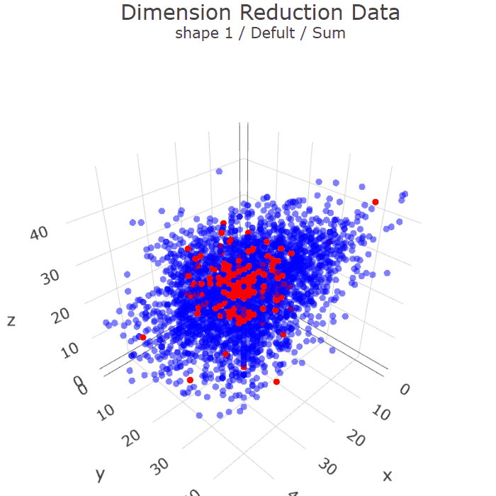
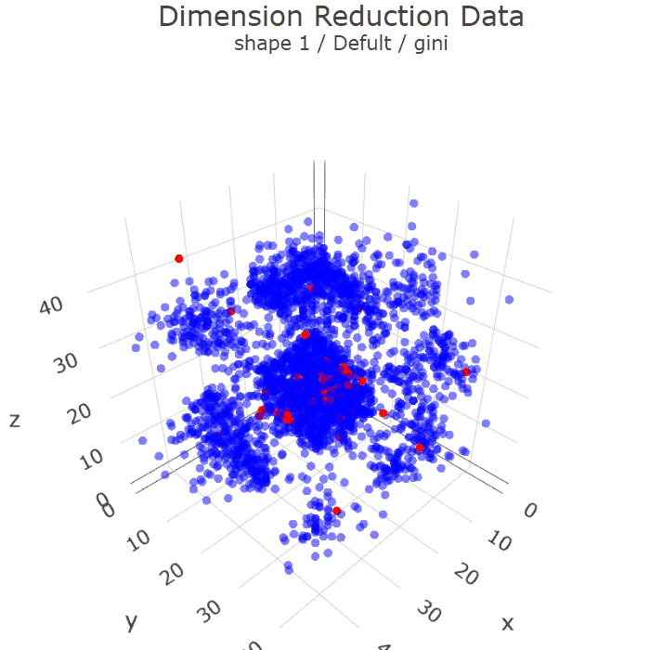
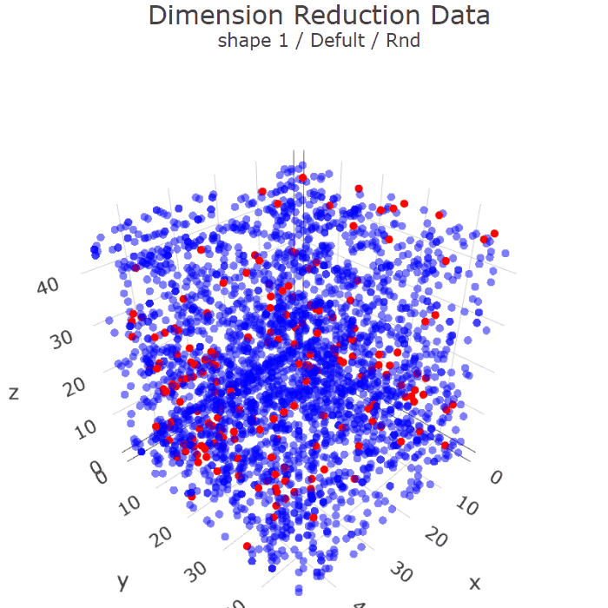
Simulated data - Dimension reduction
Sum | Impurity | RND

Slide 24
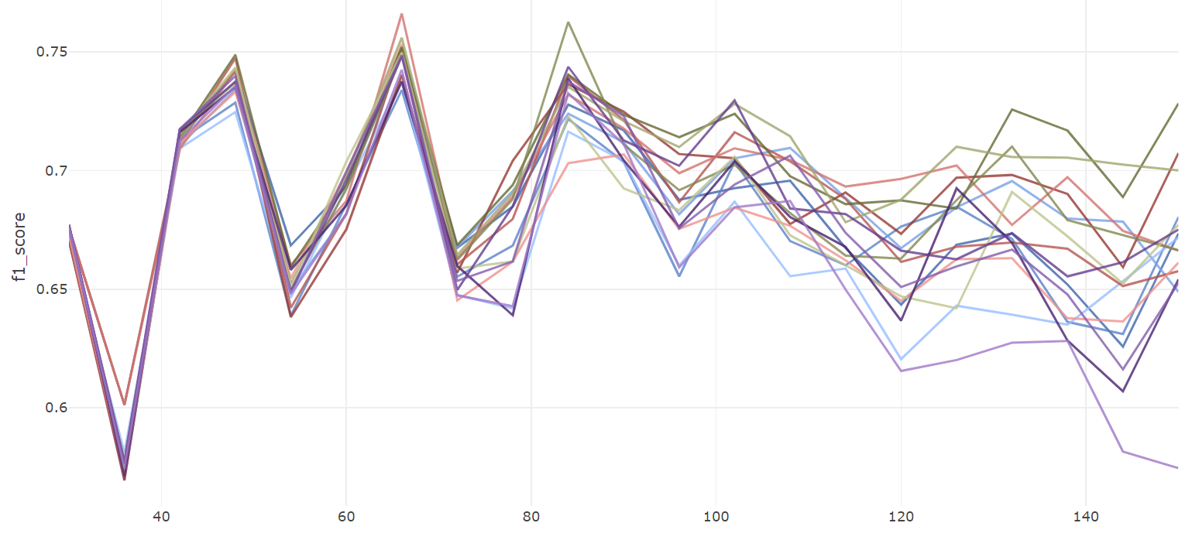
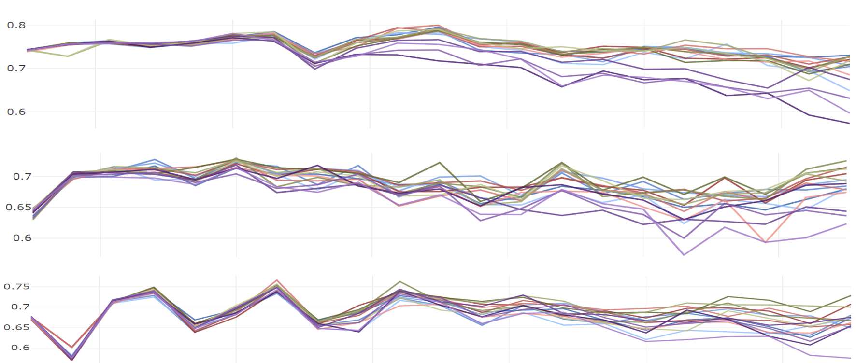
Continuous data - Classification
Dataset 1
Traditional | OneHot
 | Ordinal
 | Target
 | Binary
Default | Sum
 | Purity
 | FI
 | RND
Correlation | Sum
 | Purity
 | FI
 | RND
PCA | Sum
 | Purity
 | FI
 | RND
40 | 60 | 80 | 100 | 120 | 140
Binary Features

Slide 25
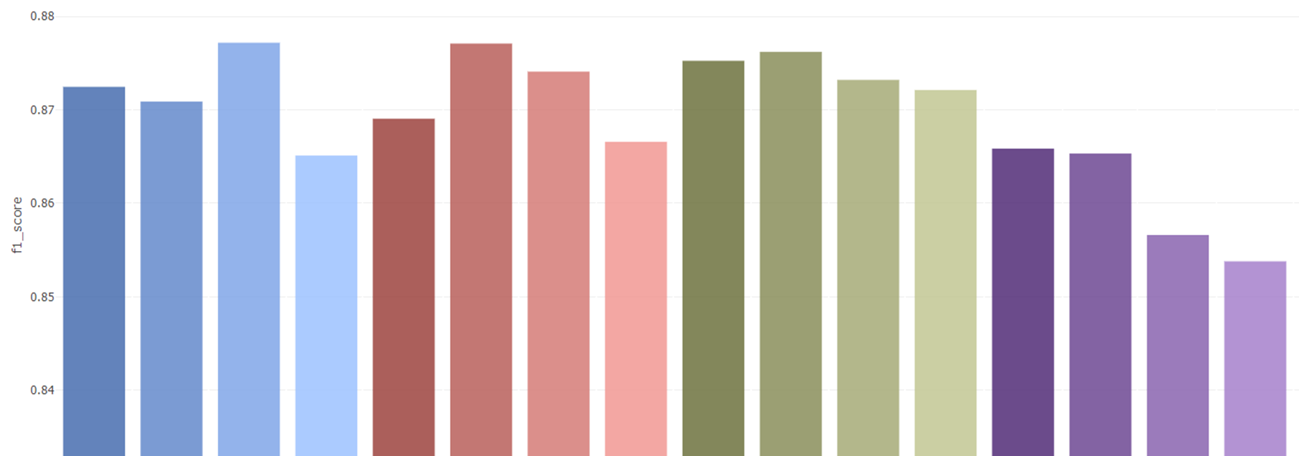
Simulated data - Classification
Dataset 1
 | OneHot | Binary | Target | Ordinal | Sum | Purity | FI | RND | Sum | Purity | FI | RND | Sum | Purity | FI | RND
 | Traditional encoding methods |  |  |  | Default |  |  |  | Correlation |  |  |  | PCA
 | ～ | ～ | 3 |  |  |  |  |  | 5

Slide 26

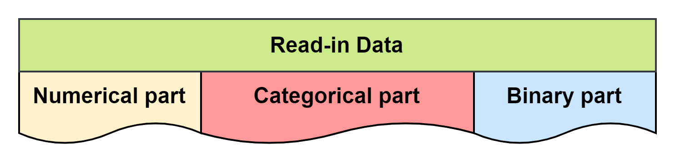
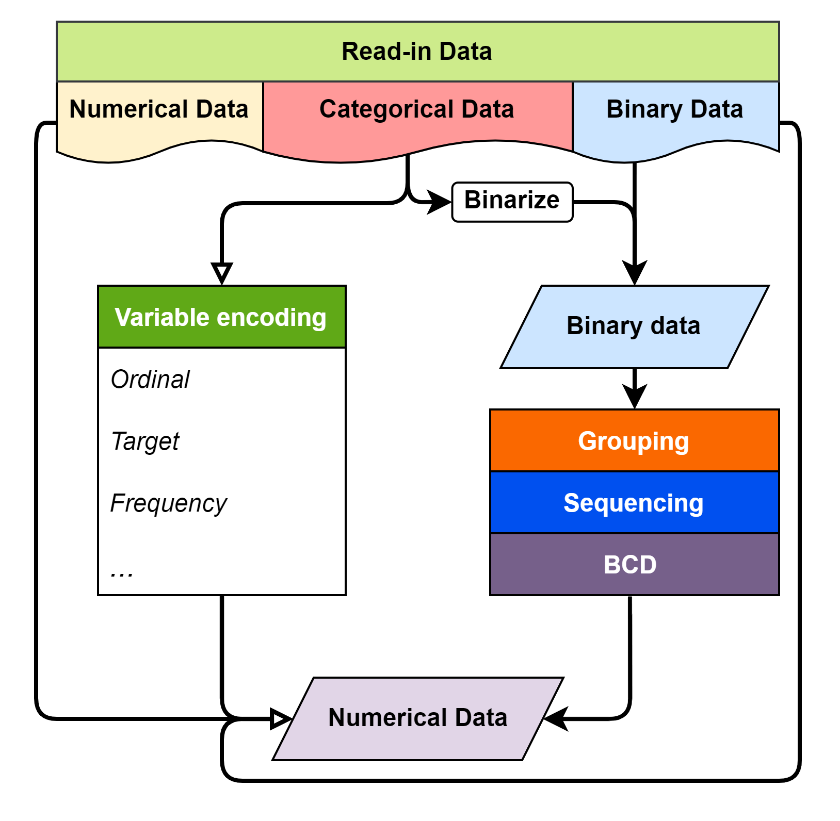
Kaggle dataset
3
9
5
One Hot
75

Slide 27
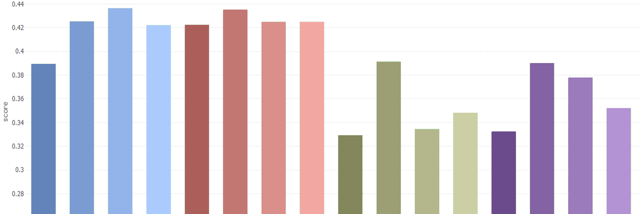
Kaggle dataset - Classification
Feature Encode Challenge
 | OneHot | Binary | Target | Ordinal | Sum | Purity | FI | RND | Sum | Purity | FI | RND | Sum | Purity | FI | RND
 | Traditional encoding methods |  |  |  | Default |  |  |  | Correlation |  |  |  | PCA
 | 83 | 38 | 18 |  |  |  |  |  | 5

Slide 28
Kaggle dataset - Classification
Feature Encode Challenge
 | OneHot | Binary | Target | Ordinal | Sum | Purity | FI | RND | Sum | Purity | FI | RND | Sum | Purity | FI | RND
 | Traditional encoding methods |  |  |  | Default |  |  |  | Correlation |  |  |  | PCA
 | 83 | 38 | 18 |  |  |  |  |  | 5

Slide 29
Conclusion
In this research, we develop a method to encode binary feature data into numerical data, which can compress the binary features information to reduce dimension while remaining a certain level in ML model classification performance. The main advantage of this method compare to traditional encoding methods are:
Encoding Binary features without group knowledge to numerical data.
Adjust the number of features of encoded numerical data.
Remain ML model performance with certain sequencing method.
Notes:
More over, after the experiments though multiple kinds of datasets, few interesting things was discovered
Default group form the categorical data often perform better than other feature selected group.
Sequencing grouped features effects on ML model performance.

Slide 30

Overview
Motivation
Introduction
Methodology
Case study
Conclusion
Notes:
Not needed

Slide 31
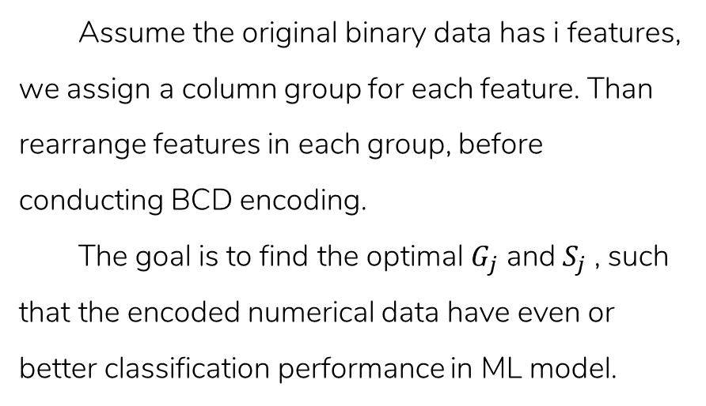
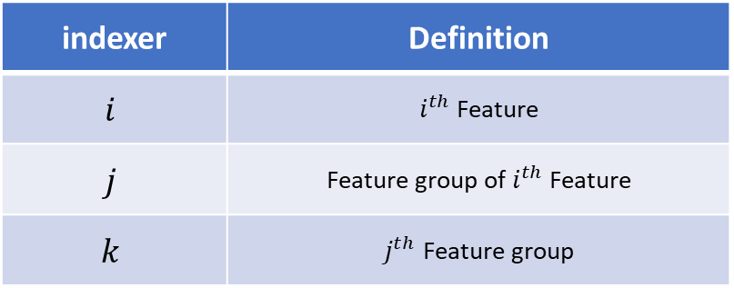
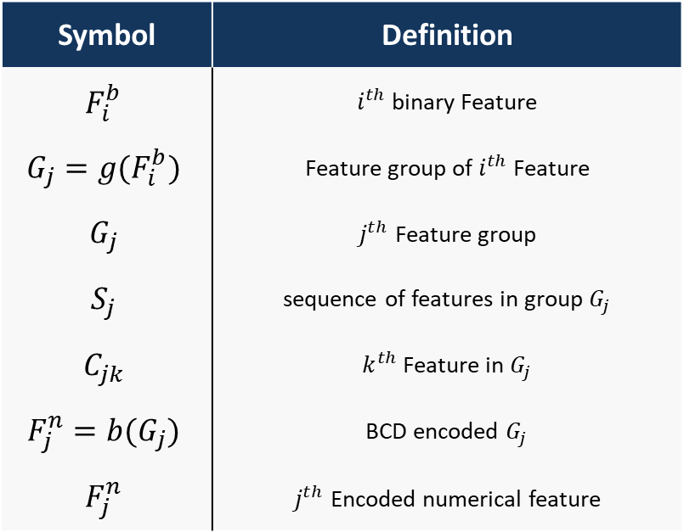
Introduction - cont.
Assume the original binary data has i features, we assign a column group for each feature. Than rearrange features in each group, before conducting BCD encoding.
The goal is to find the optimal $G_{j}$ and $S_{j}$ , such that the encoded numerical data have even or better classification performance in ML model.
Symbol | Definition
$$F_{i}^{b}$$ | $i^{th}$ binary Feature
$$G_{j}=g(F_{i}^{b})$$ | Feature group of $i^{th}$ Feature
$$G_{j}$$ | $j^{th}$ Feature group
$$S_{j}$$ | sequence of features in group $G_{j}$
$$C_{jk}$$ | $k^{th}$ Feature in $G_{j}$
$$F_{j}^{n}=b(G_{j})$$ | BCD encoded $G_{j}$
$$F_{j}^{n}$$ | $j^{th}$ Encoded numerical feature
indexer | Definition
$$i$$ | $i^{th}$ Feature
$$j$$ | Feature group of $i^{th}$ Feature
$$k$$ | $j^{th}$ Feature group
Notes:
可以先不要

Slide 32
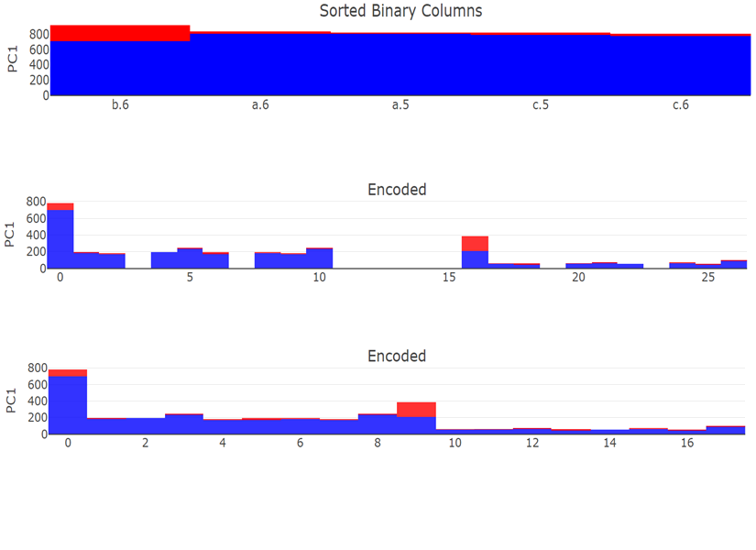
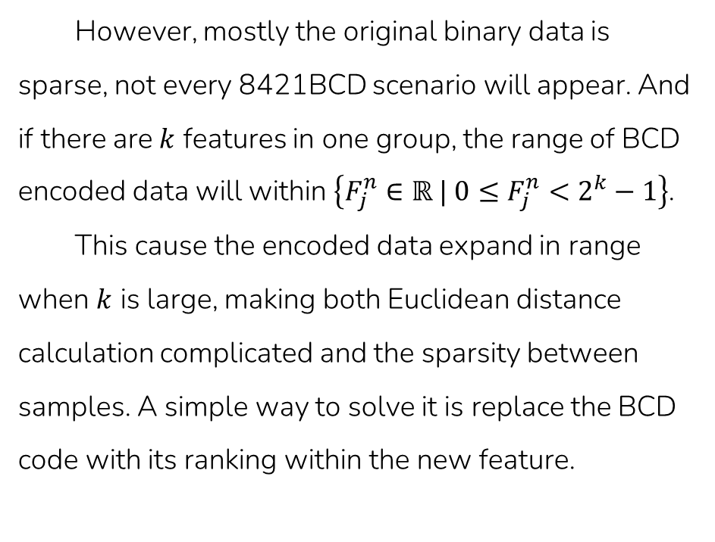
Methodology - BCD encode
However, mostly the original binary data is sparse, not every 8421BCD scenario will appear. And if there are $k$ features in one group, the range of BCD encoded data will within $\left\{F_{j}^{n}∈ℝ | 0≤F_{j}^{n}<2^{k}−1\right\}$.
This cause the encoded data expand in range when $k$ is large, making both Euclidean distance calculation complicated and the sparsity between samples. A simple way to solve it is replace the BCD code with its ranking within the new feature.
Sorted
BCD
Ranked
Notes:
別別別

Slide 33
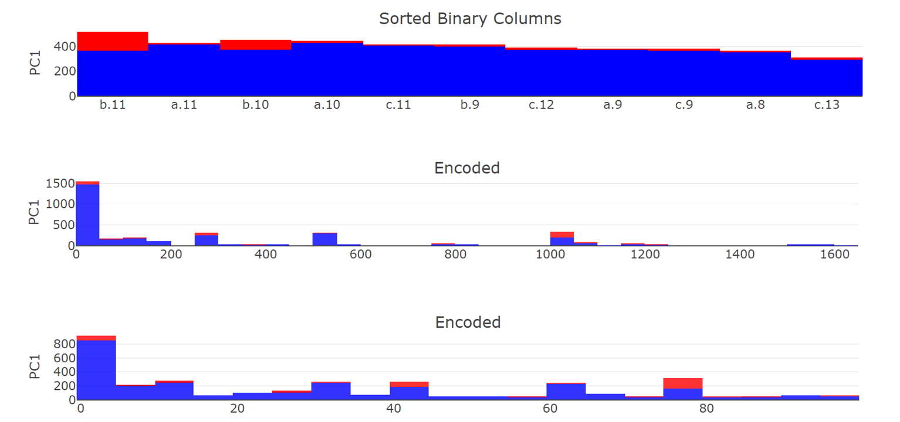
Methodology - BCD encode
Sorted
BCD
Ranked

Slide 34
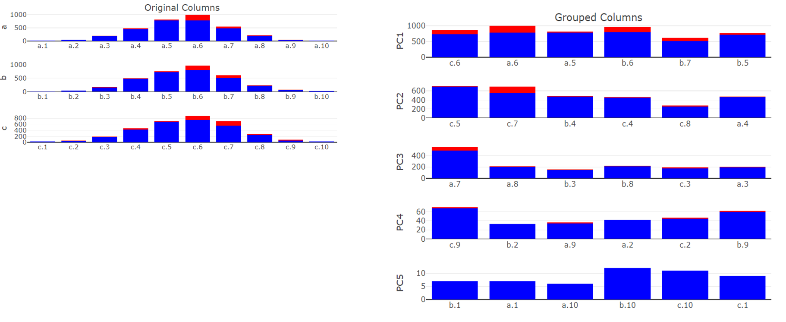
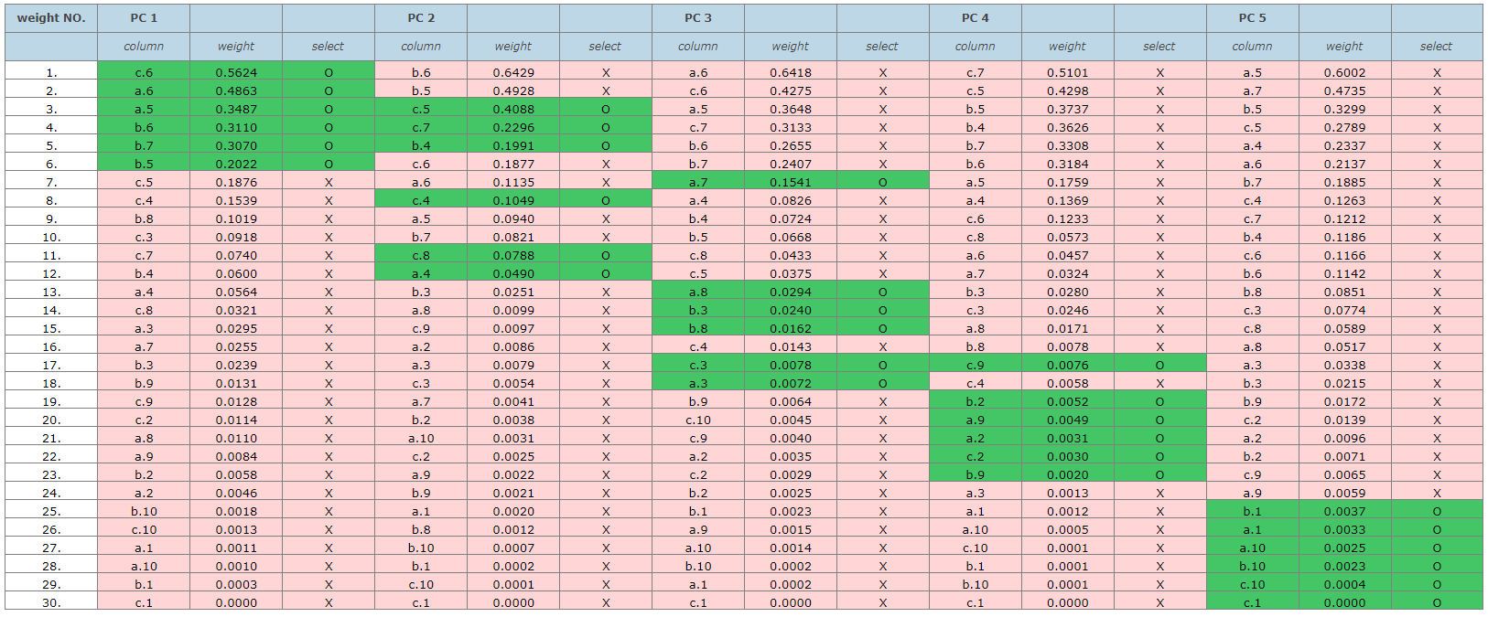
Simulated data - group by PCA
Binarize Data | Grouped by PCA

Slide 35
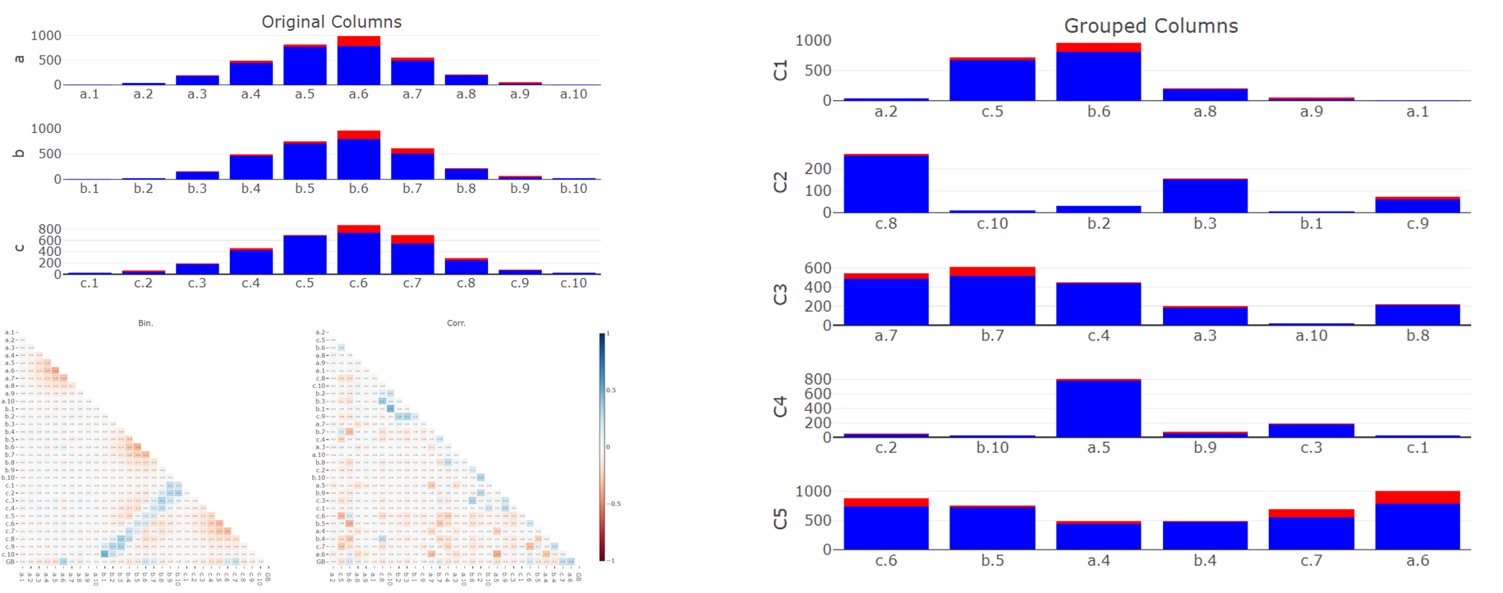
Continuous data - group by Corr.
Original Group | Grouped by Correlation

Slide 36
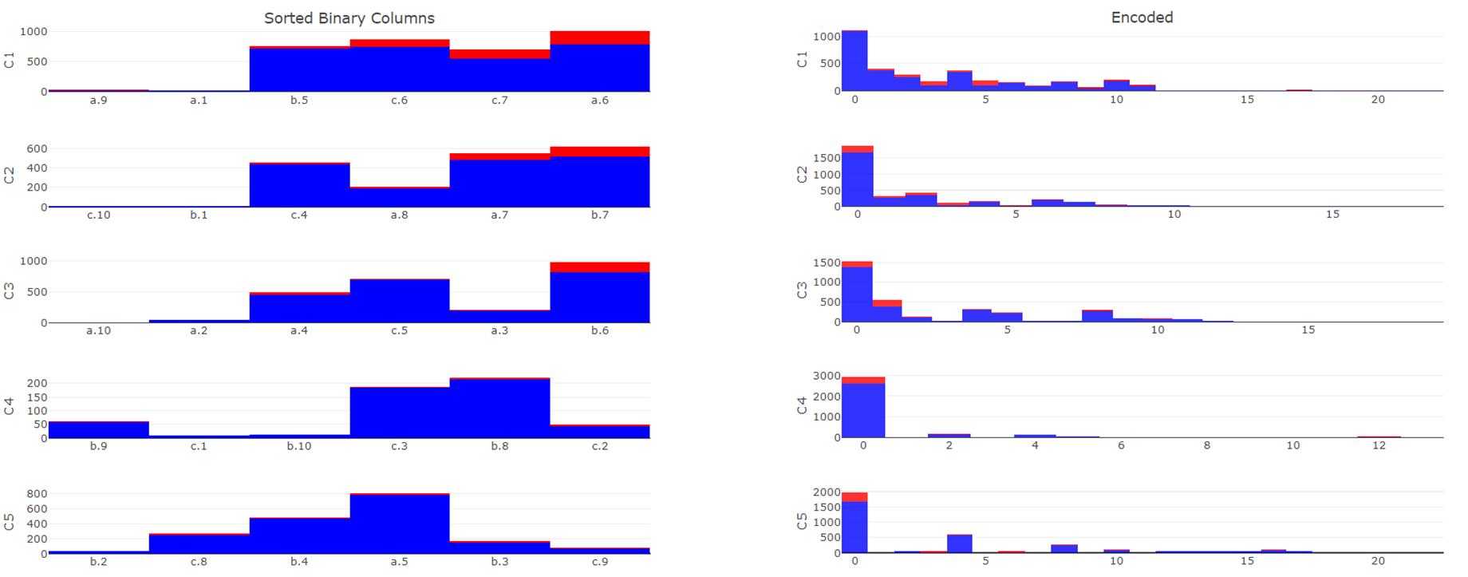
Simulated data - seq. by impurity
Sequence by impurity | BCD encoded

Slide 37
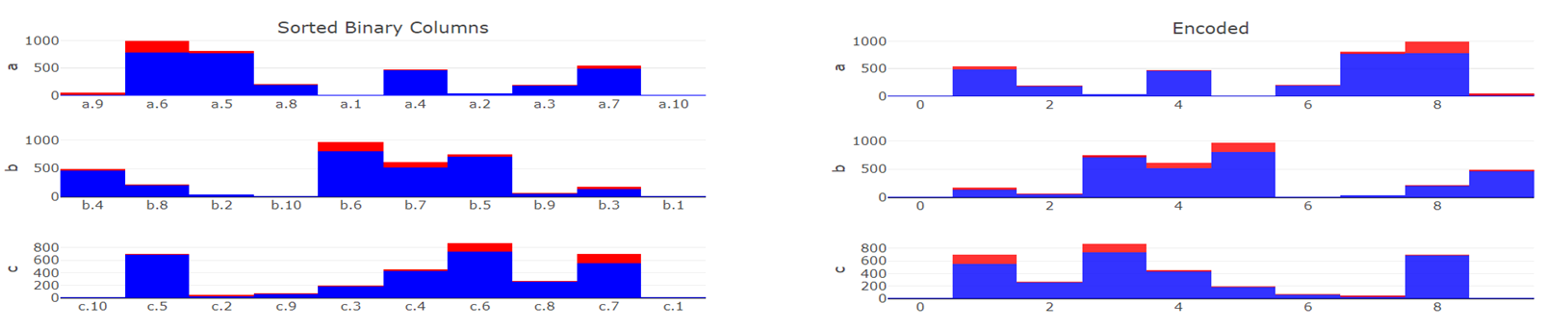
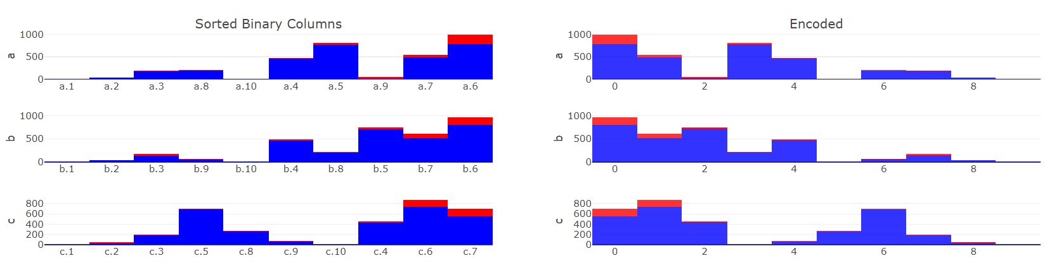
Simulated data - seq. comparison
 | Sequenced | BCD
Randomly
By Impurity

Slide 38
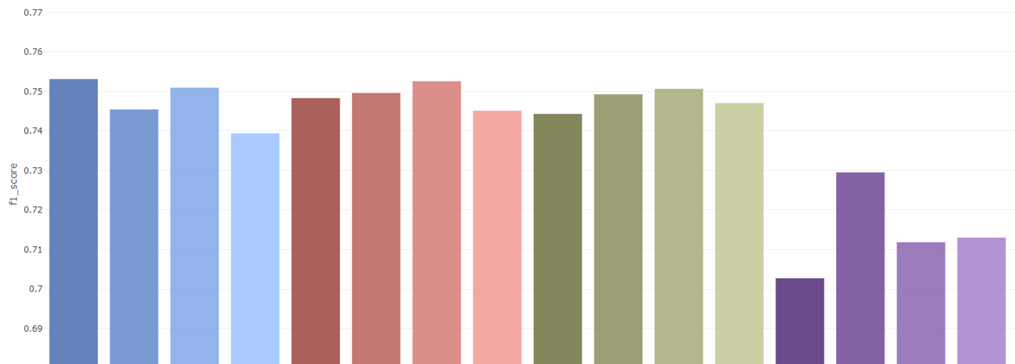
Simulated data - Classification
Shape 1
 | OneHot | Ordinal | Target | Binary | Sum | Purity | FI | RND | Sum | Purity | FI | RND | Sum | Purity | FI | RND
 | Traditional encoding methods |  |  |  | Default |  |  |  | Correlation |  |  |  | PCA

Slide 39
Simulated data - Classification
Shape 3
 | OneHot | Ordinal | Target | Binary | Sum | Purity | FI | RND | Sum | Purity | FI | RND | Sum | Purity | FI | RND
 | Traditional encoding methods |  |  |  | Default |  |  |  | Correlation |  |  |  | PCA

